Slide 1




Randomness in Computing
LECTURE 13
Last time
Finished routing on hypercube
Balls into bins model
Today
Poisson distribution
Poisson approximation
CS
537
Sofya Raskhodnikova;Randomness in Computing

Slide 2

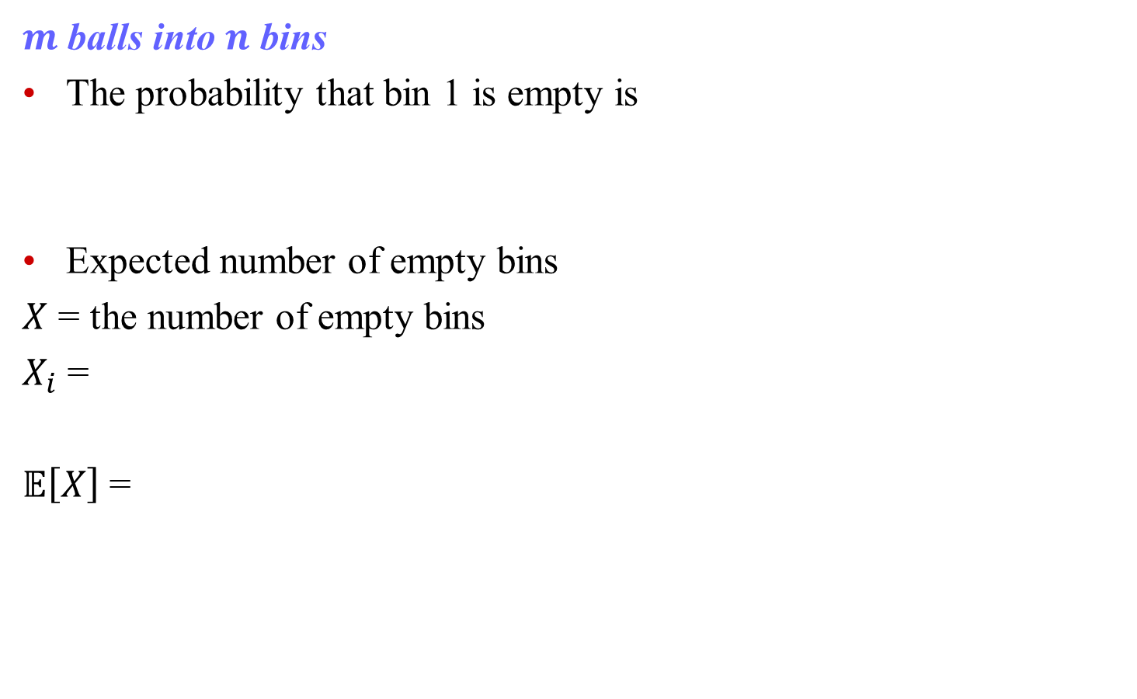

The number of empty bins
$m$ balls into $n$ bins
The probability that bin 1 is empty is
Expected number of empty bins
$X$ = the number of empty bins
$X_{i}$ =
$𝔼\left[X\right]$ =
for $x≤1/2$
$$e^{−x−x^{2}}≤1−x≤x^{−x}$$

Slide 3

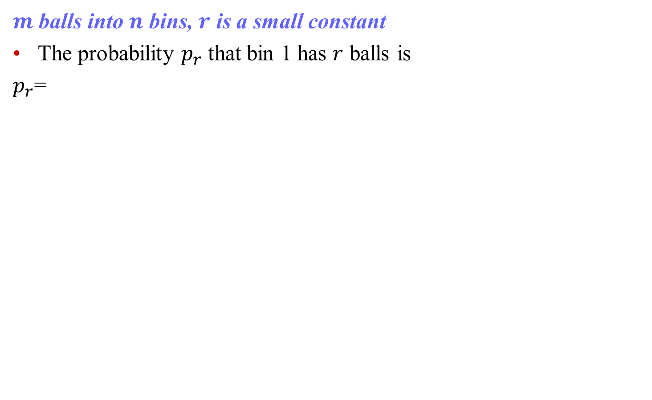
The number of bins with $r$ balls
$m$ balls into $n$ bins, $r$ is a small constant
The probability $p_{r}$ that bin 1 has $r$ balls is
$p_{r}$=

Slide 4
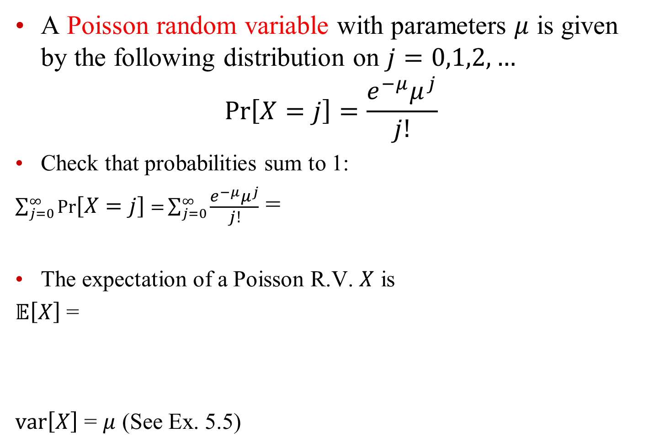

Poisson random variables
A Poisson random variable with parameters $μ$ is given by the following distribution on $j=0,1,2,…$
$$\operatorname{Pr}\left[X=j\right]=\frac{e^{−μ}μ^{j}}{j!}$$
Check that probabilities sum to 1:
$\sum_{j=0}^{∞}{\operatorname{Pr}\left[X=j\right]=}\sum_{j=0}^{∞}{\frac{e^{−μ}μ^{j}}{j!}}$ =
The expectation of a Poisson R.V. $X$ is
$𝔼\left[X\right]$ =
$var\left[X\right]$ = $μ$ (See Ex. 5.5)
Taylor expansion:$e^{x}=\sum_{j=0}^{∞}{\frac{x^{j}}{j!}}$

Slide 5
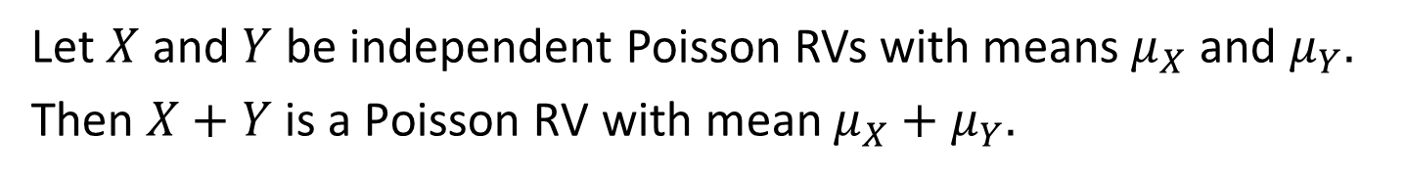
Independent Poisson RVs
Theorem
Let $X$ and $Y$ be independent Poisson RVs with means $μ_{X}$ and $μ_{Y}.$
Then $X+Y$ is a Poisson RV with mean $μ_{X}+μ_{Y}.$

Slide 6
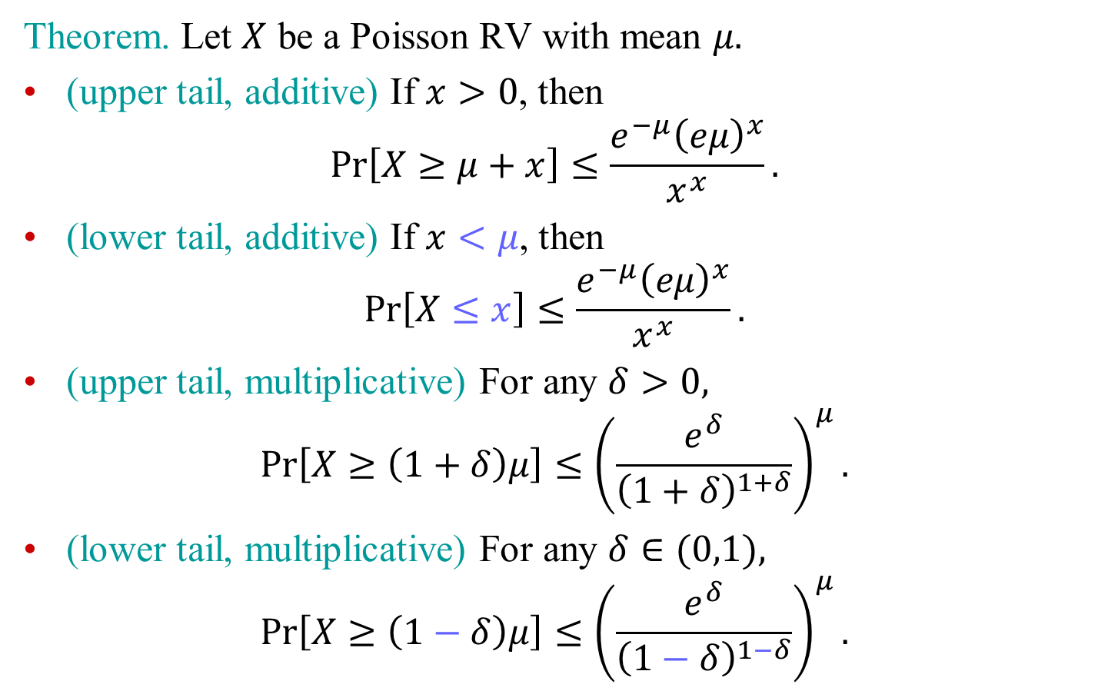
Chernoff Bounds for Poisson RVs
Theorem. Let $X$ be a Poisson RV with mean $μ.$
(upper tail, additive) If $x>0$, then
$$\operatorname{Pr}\left[X≥μ+x\right]≤\frac{e^{−μ}{\left(eμ\right)}^{x}}{x^{x}}.$$
(lower tail, additive) If $x<μ$, then
$$\operatorname{Pr}\left[X≤x\right]≤\frac{e^{−μ}{\left(eμ\right)}^{x}}{x^{x}}.$$
(upper tail, multiplicative) For any $δ>0,$
$$\operatorname{Pr}\left[X≥\left(1+δ\right)μ\right]≤{\left(\frac{e^{δ}}{{\left(1+δ\right)}^{1+δ}}\right)}^{μ}.$$
(lower tail, multiplicative) For any $δ∈(0,1),$
$$\operatorname{Pr}\left[X≥\left(1−δ\right)μ\right]≤{\left(\frac{e^{δ}}{{\left(1−δ\right)}^{1−δ}}\right)}^{μ}.$$

Slide 7
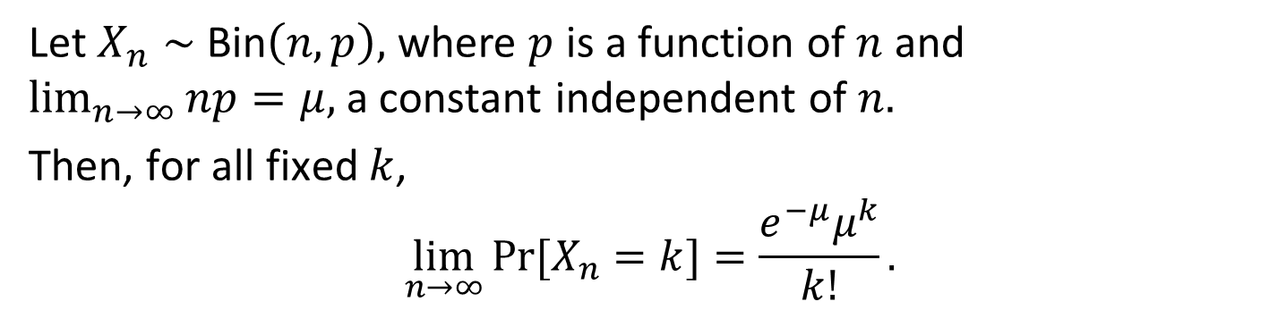
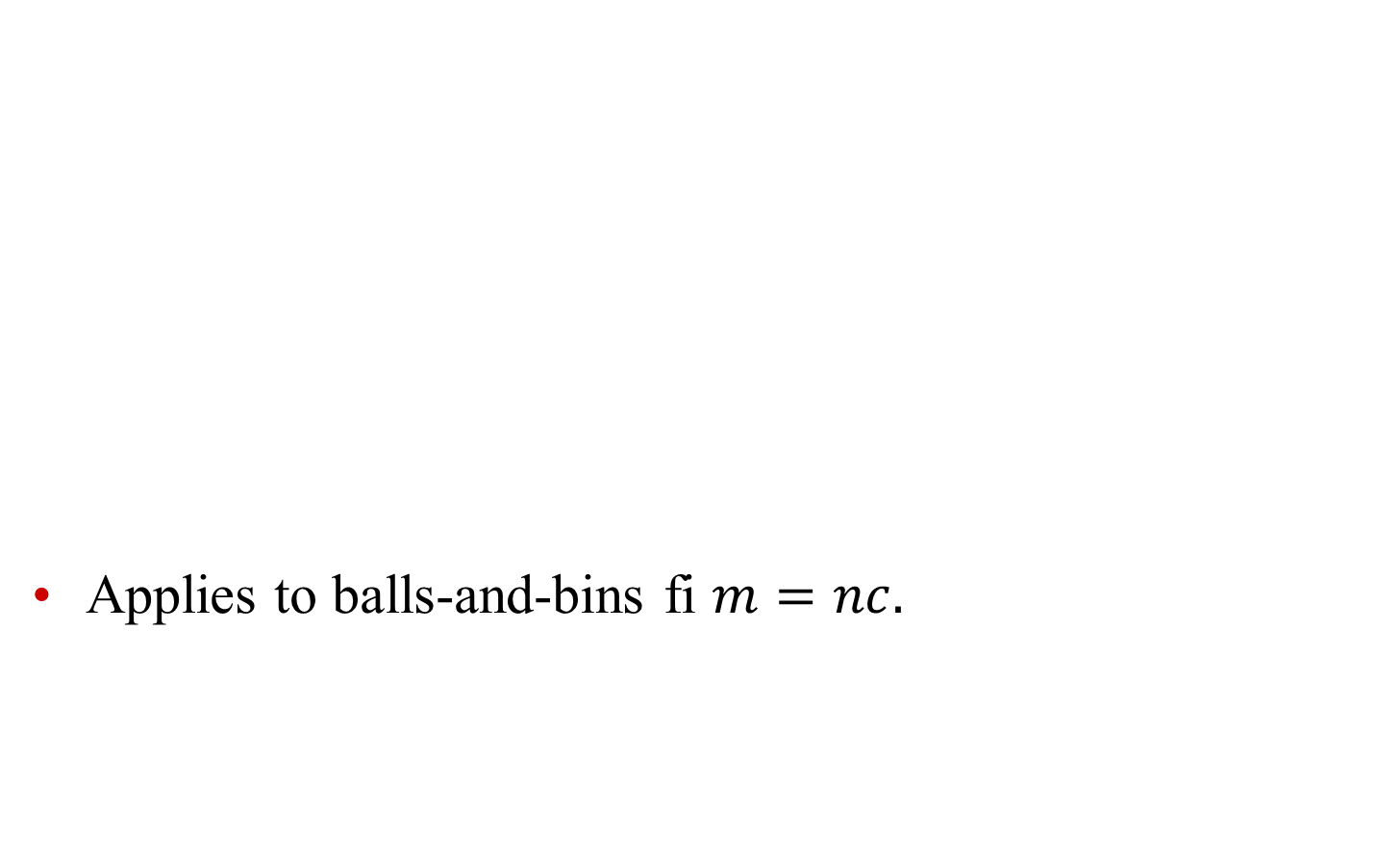
Poisson Distribution is Limit of Binomial Distribution
Applies to balls-and-bins fi $m=nc.$
Theorem
Let $X_{n}∼$ Bin$\left(n,p\right),$ where $p$ is a function of $n$ and $\lim_{n→∞}{np}=μ,$ a constant independent of $n.$
Then, for all fixed $k$,
$$\lim_{n→∞}{Pr⁡[X_{n}}=k]=\frac{e^{−μ}μ^{k}}{k!}.$$

